Slide 1
Multimodal Perception and Comprehension of Corner Cases in Autonomous Driving

Slide 2
Opening Remarks and Welcome Songcen Xu

Slide 3
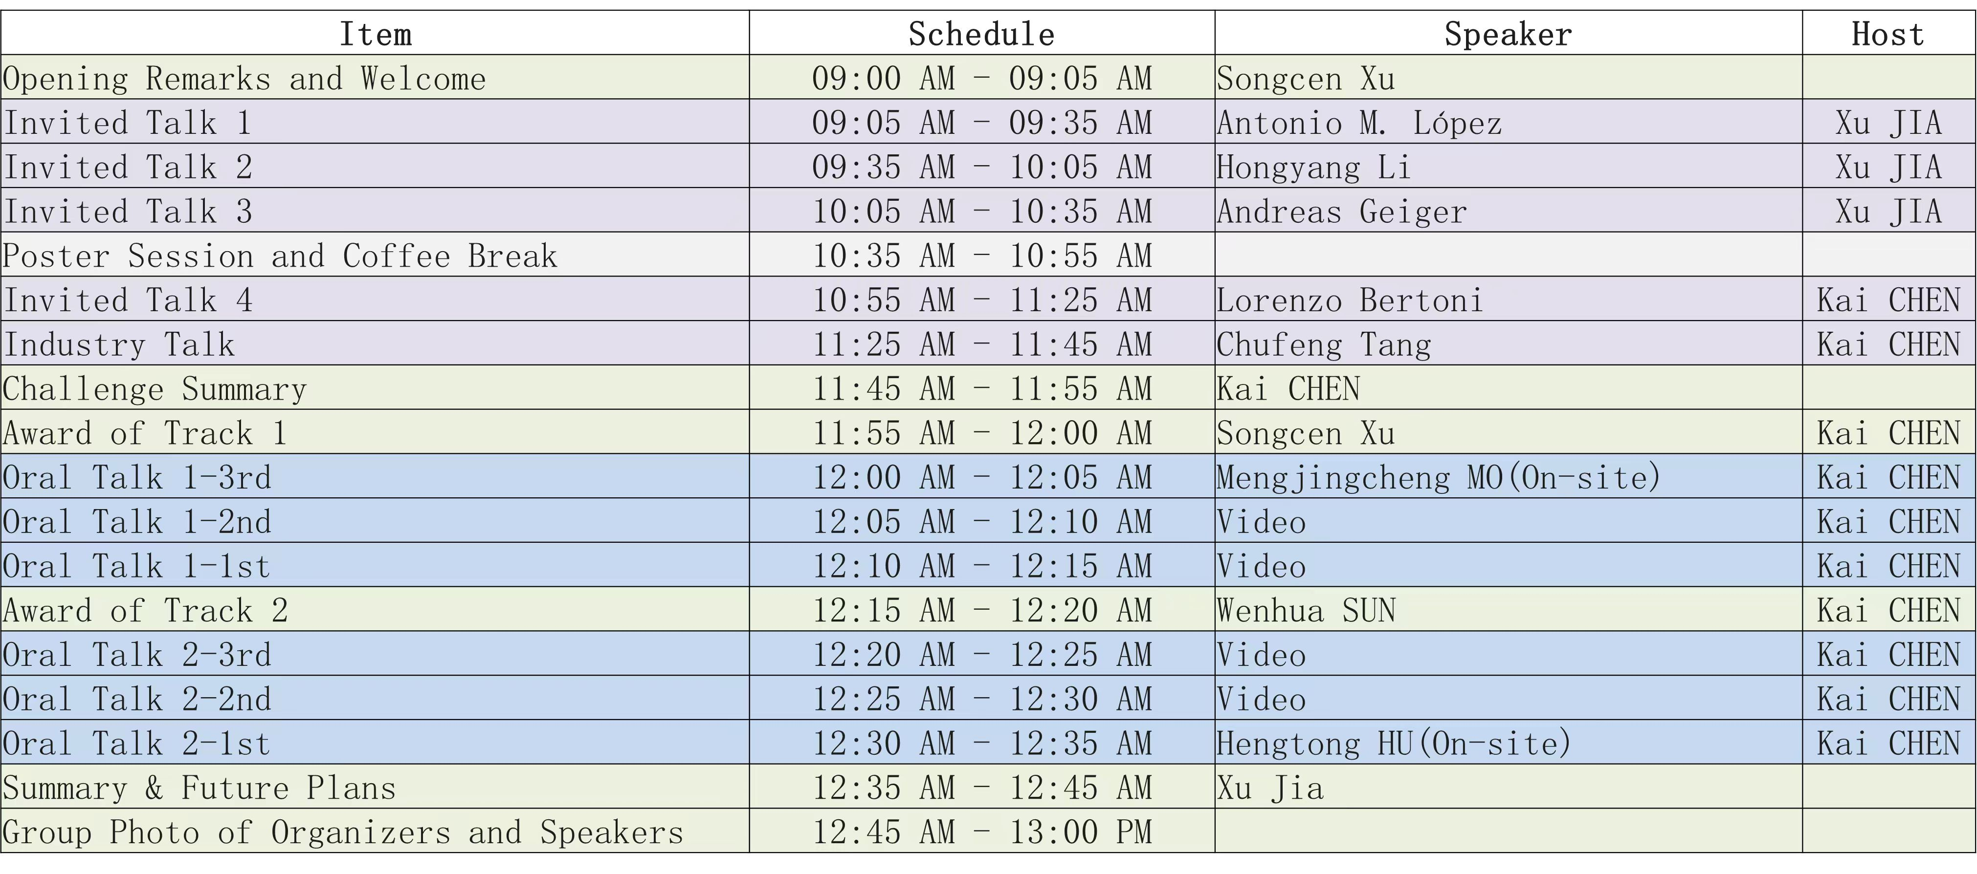

Slide 4
Vision-based End-to-end Driving by Imitation Learning Antonio M. López

Slide 5
Reasoning Multi-Agent Behavioral Topology for Interactive Autonomous Driving Hongyang Li

Slide 6
Simulating and Benchmarking Self-Driving Cars Andreas Geiger

Slide 7
Poster Session and Coffee Break

Slide 9
Long-tail Scenario Generation for Autonomous Driving with World Models Lorenzo Bertoni

Slide 10
Industrial Talk on Autonomous Driving Chufeng Tang

Slide 12
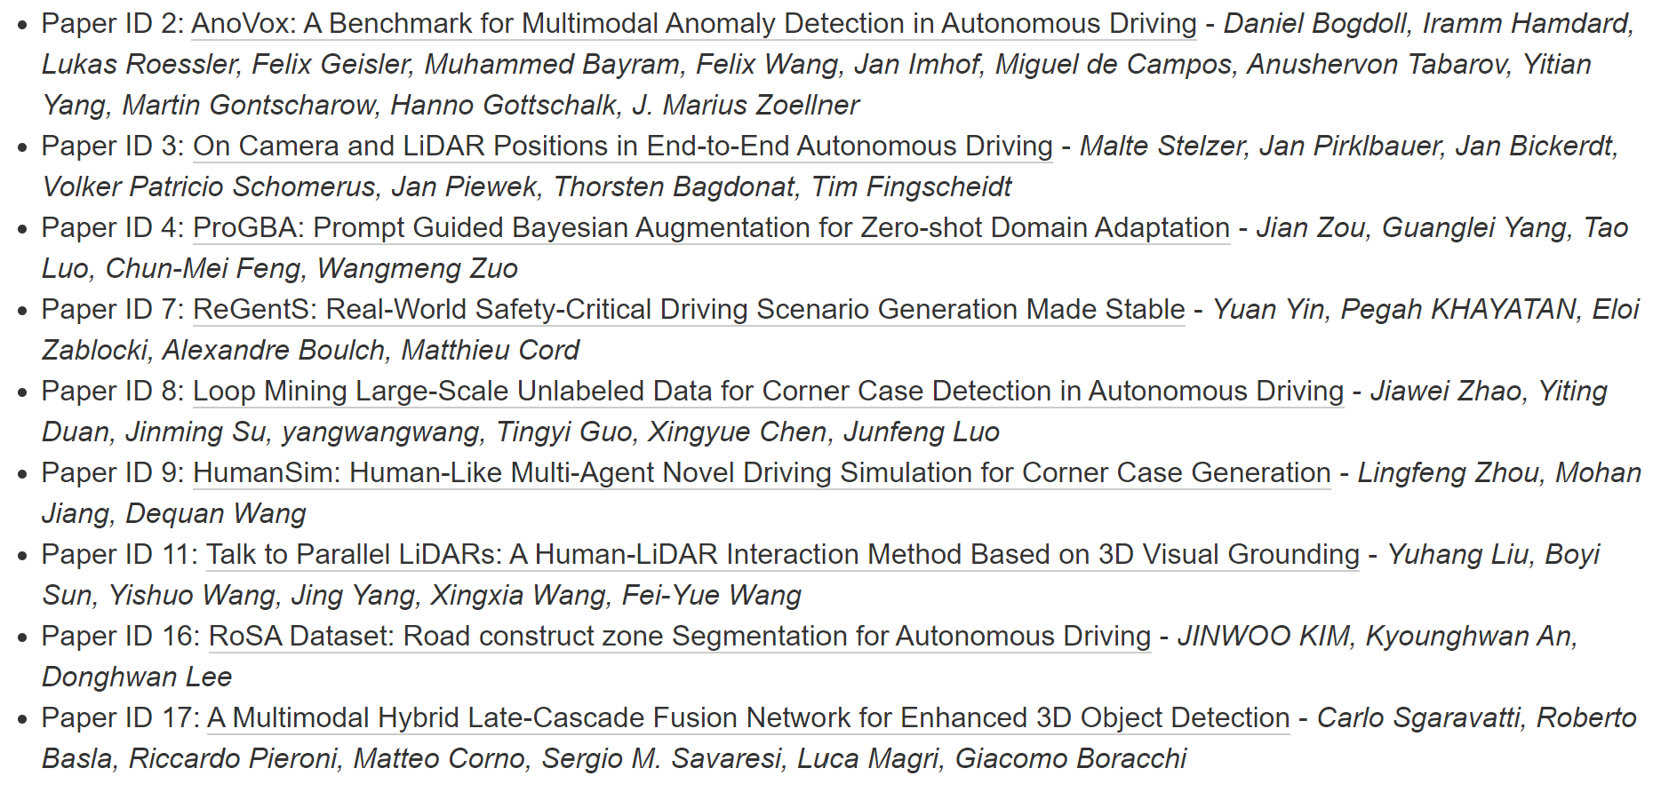
Workshop Accepted Papers (Full Track)

Slide 13
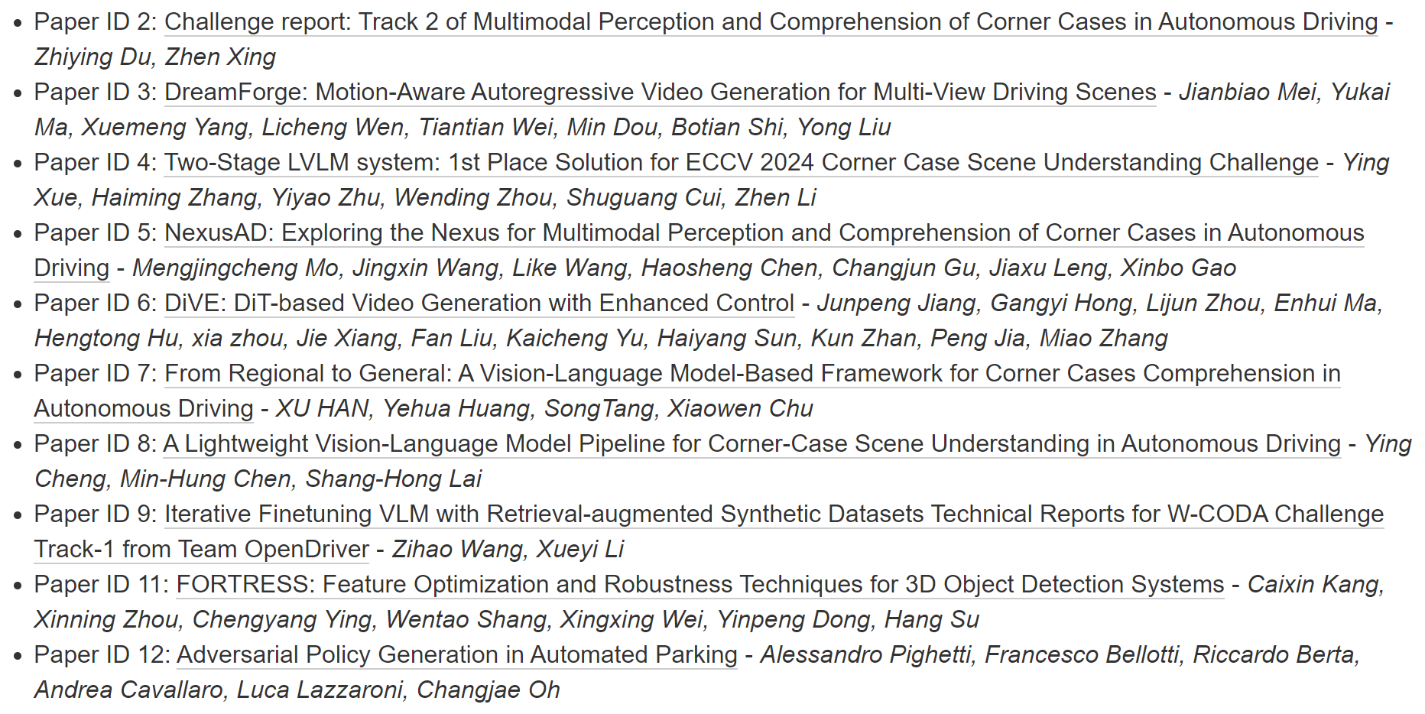
Workshop Accepted Papers (Abstract Track)

Slide 14
Challenge Summary & Awards

Slide 15
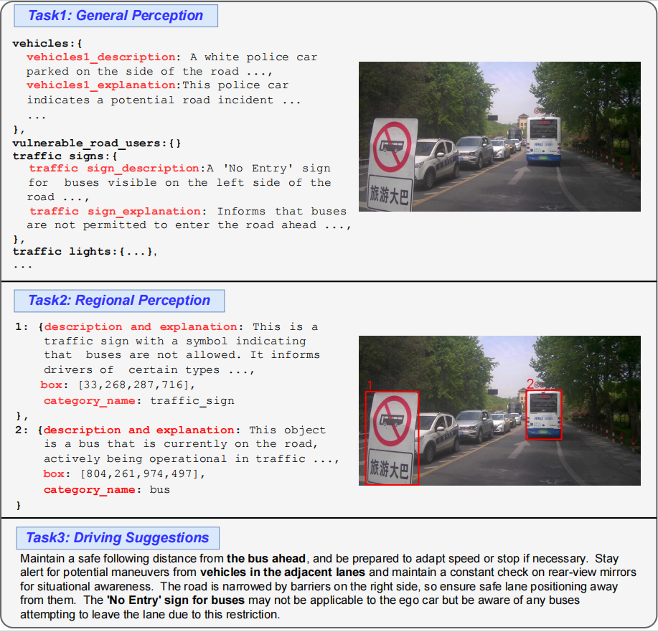
Track 1: Corner Case Scene Understanding
Track 1 focuses on enhancing multimodal perception and comprehension capabilities of MLLMs for autonomous driving, emphasizing global scene understanding, local area reasoning, and actionable navigation.
The goal is to promote the development of more reliable and interpretable autonomous driving.
It utilizes the CODA-LM dataset, which includes around 10,000 images and textual descriptions covering global driving scenarios, corner case analyses, and future driving recommendations.

Slide 16
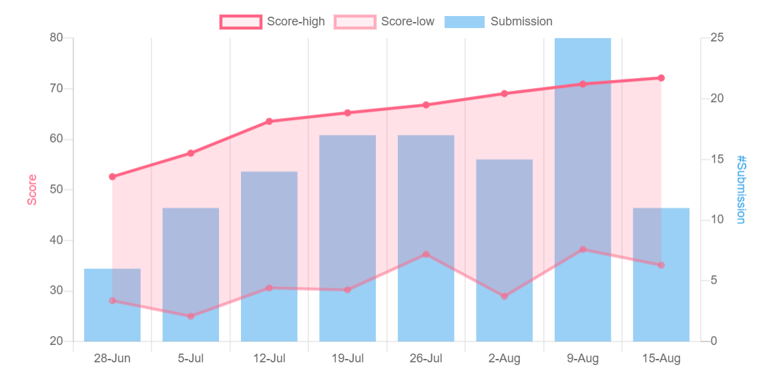
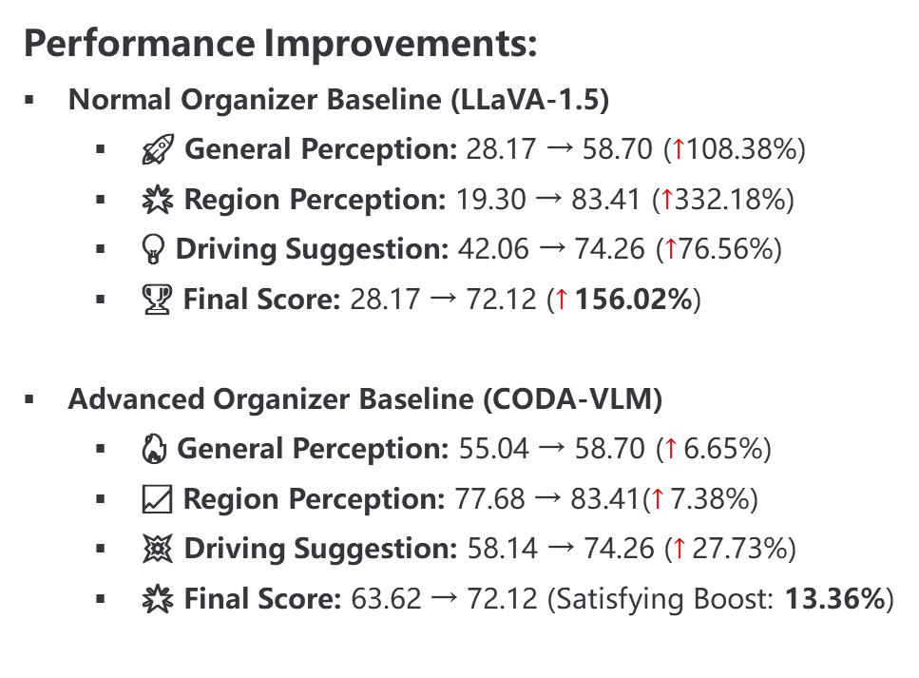
Track 1: Statistics
Submission:
🔥 Participants: 50+ teams, 100+ individuals, 30+ institutions
📊 Submissions: 100+ entries
Performance Improvements:
Normal Organizer Baseline (LLaVA-1.5)
🚀 General Perception: 28.17 → 58.70 ($↑$108.38%)
🌟 Region Perception: 19.30 → 83.41 ($↑$332.18%)
💡 Driving Suggestion: 42.06 → 74.26 ($↑$76.56%)
🏆 Final Score: 28.17 → 72.12 ($↑$156.02%)
Advanced Organizer Baseline (CODA-VLM)
🔥 General Perception: 55.04 → 58.70 ($↑$6.65%)
📈 Region Perception: 77.68 → 83.41($↑$7.38%)
💥 Driving Suggestion: 58.14 → 74.26 ($↑$27.73%)
🌟 Final Score: 63.62 → 72.12 (Satisfying Boost: 13.36%)

Slide 17
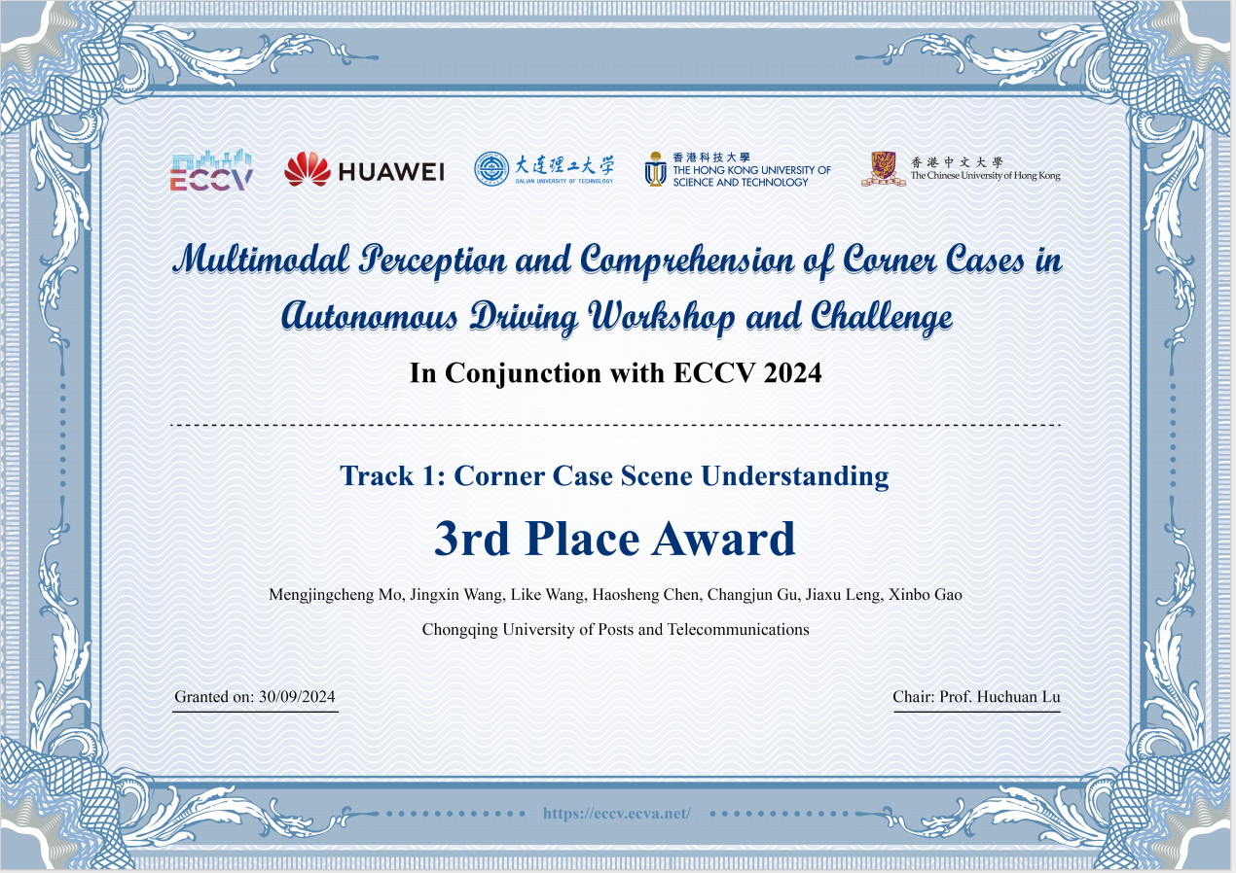
Track 1: Winner & Award
Notes:
奖状图片是旧的，需要更新

Slide 18
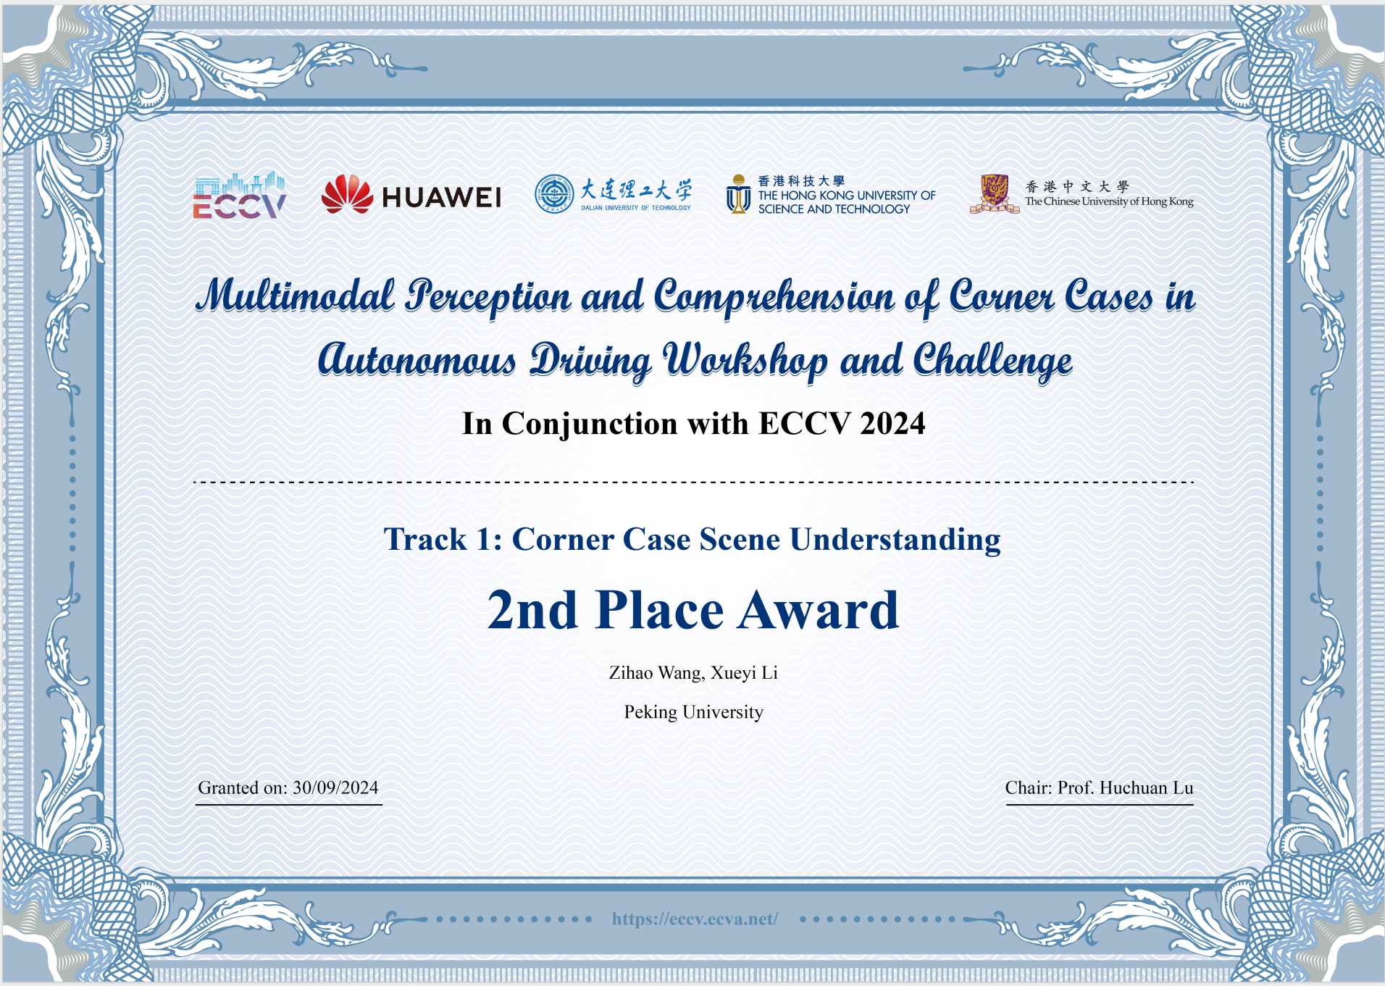
Track 1: Winner & Award
Notes:
奖状图片是旧的，需要更新

Slide 19
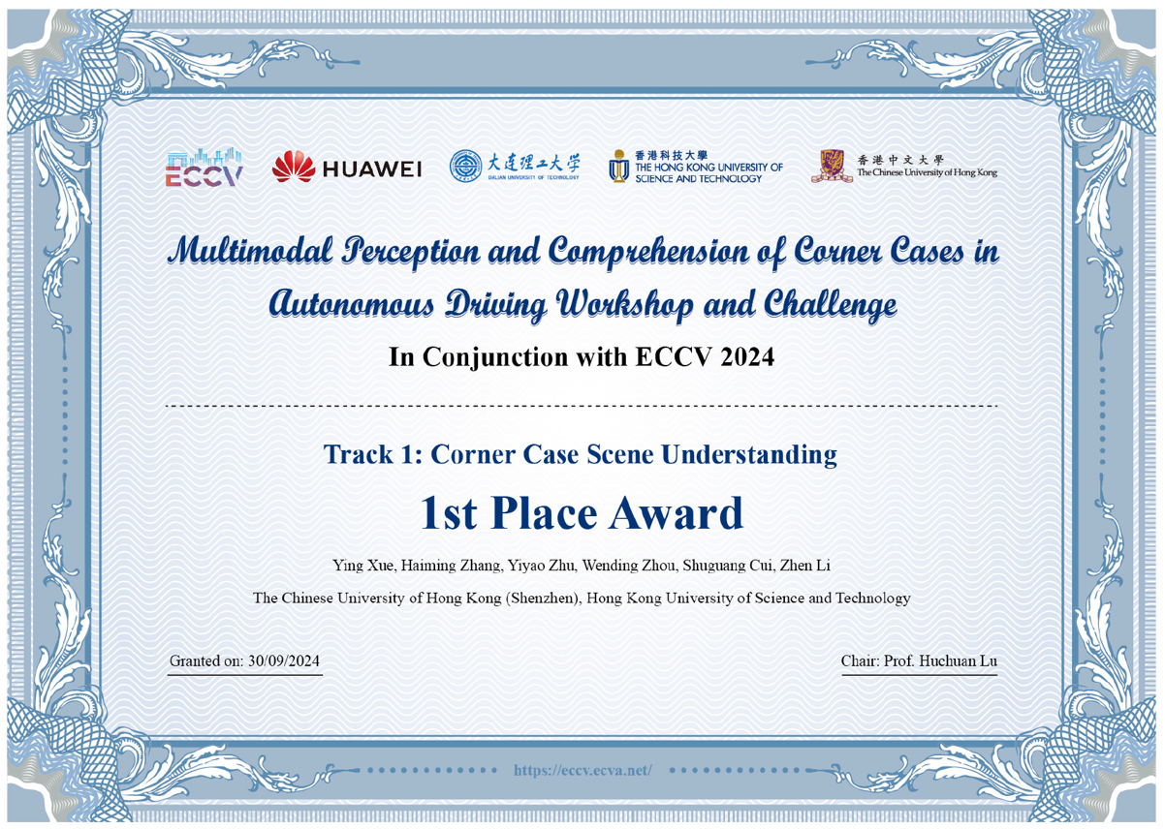
Track 1: Winner & Award
Notes:
奖状图片是旧的，需要更新

Slide 20
Post-Credits !!!

Slide 21

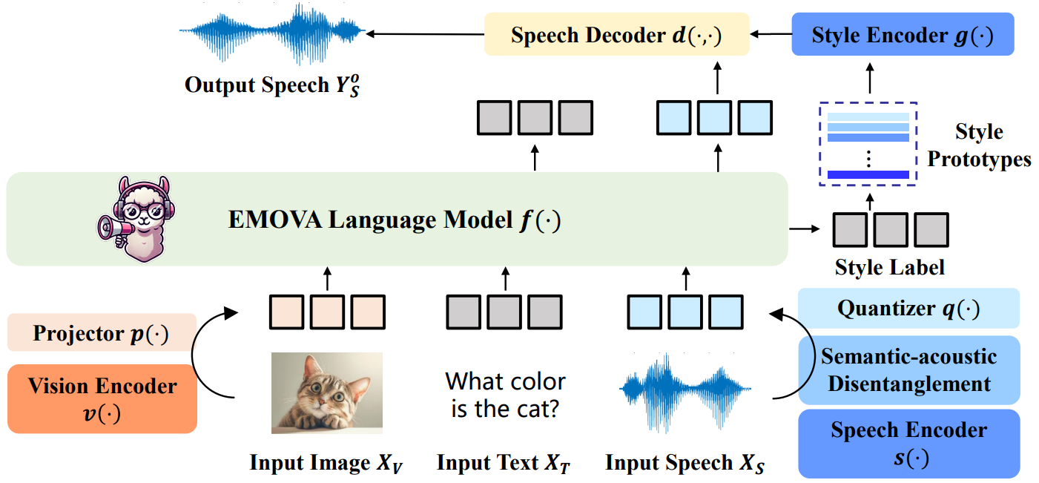
EMOVA: Empowering LMs to See, Hear and Speak
End-to-end omni-modal foundational model
Capable of dealing with visual, text and speech data simultaneously
Semantic-acoustic disentangled speech tokenizer

Slide 22

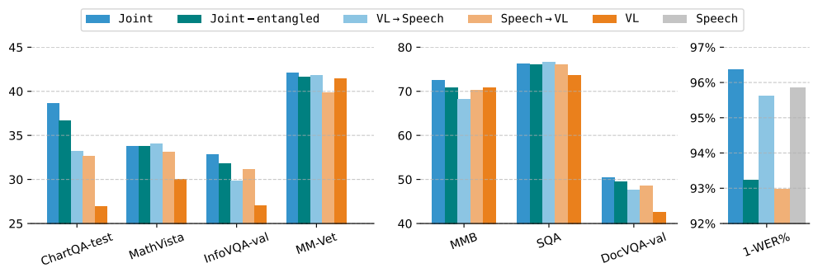
EMOVA: Empowering LMs to See, Hear and Speak
Omni-modal alignment benefits
Observation 1: image-text and speech-unit-text data benefit each other.
Observation 2: semantic-acoustic disentanglement benefits omni-modal alignment.
Observation 3: sequential alignment is not optimal.

Slide 23
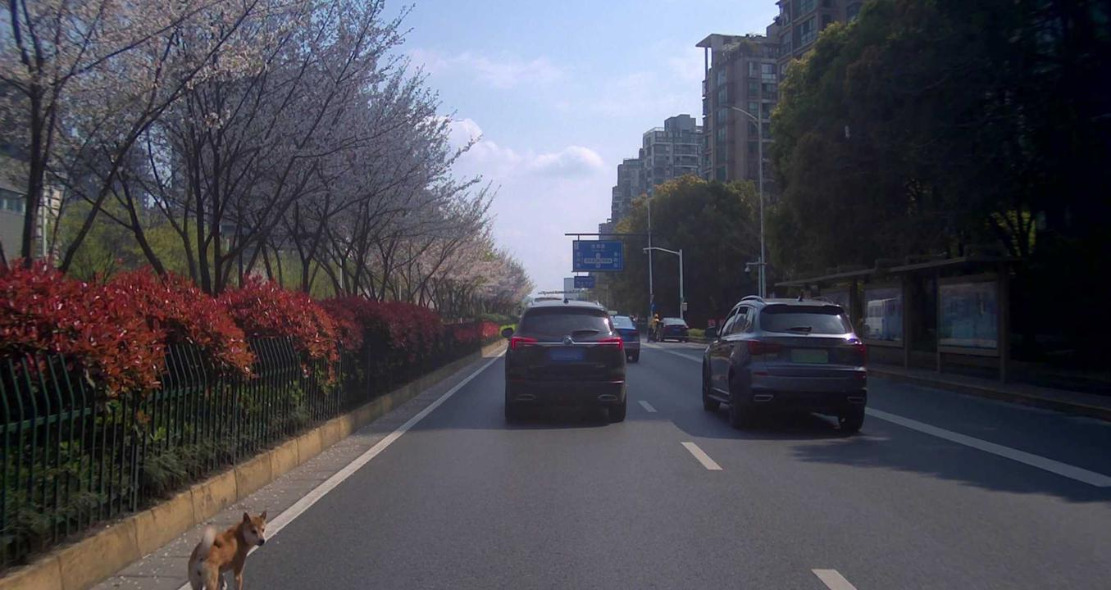

EMOVA: Empowering LMs to See, Hear and Speak
Q:
A:
Not trained with any road samples!

Slide 24
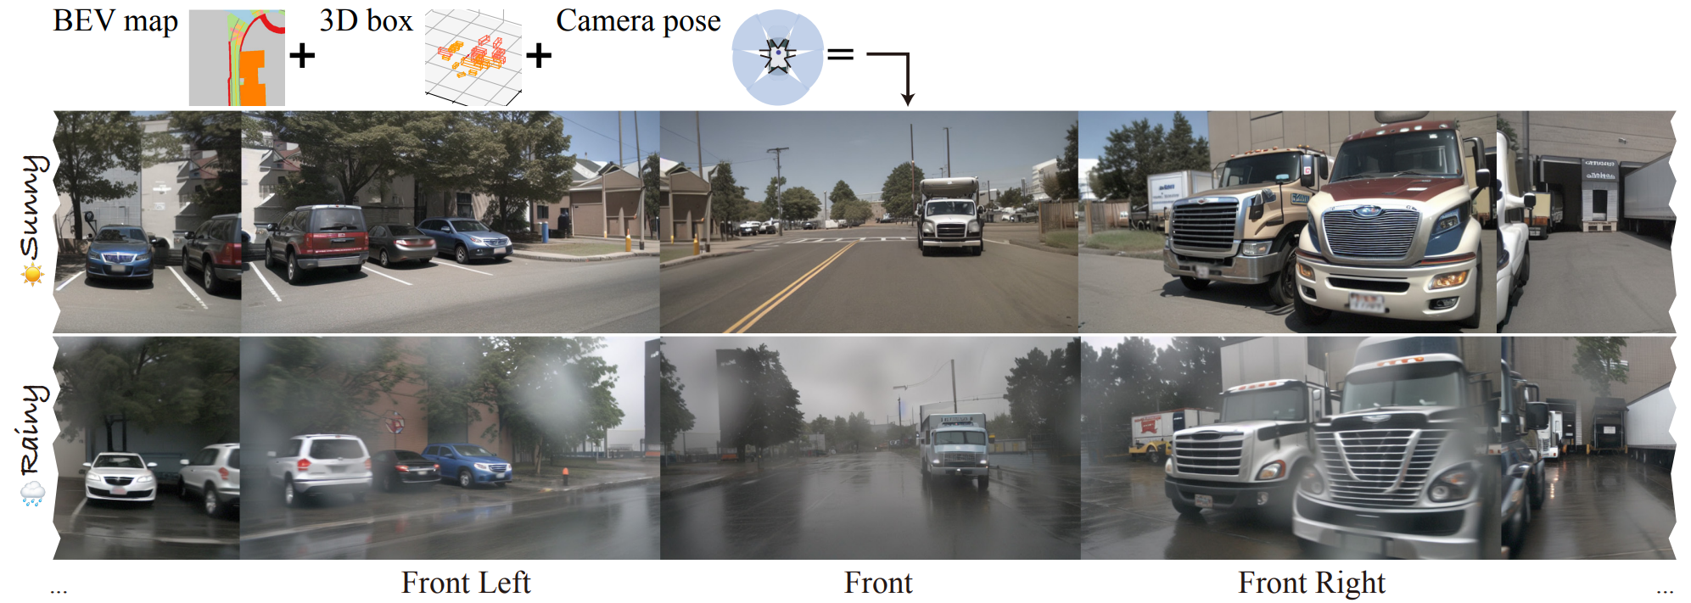
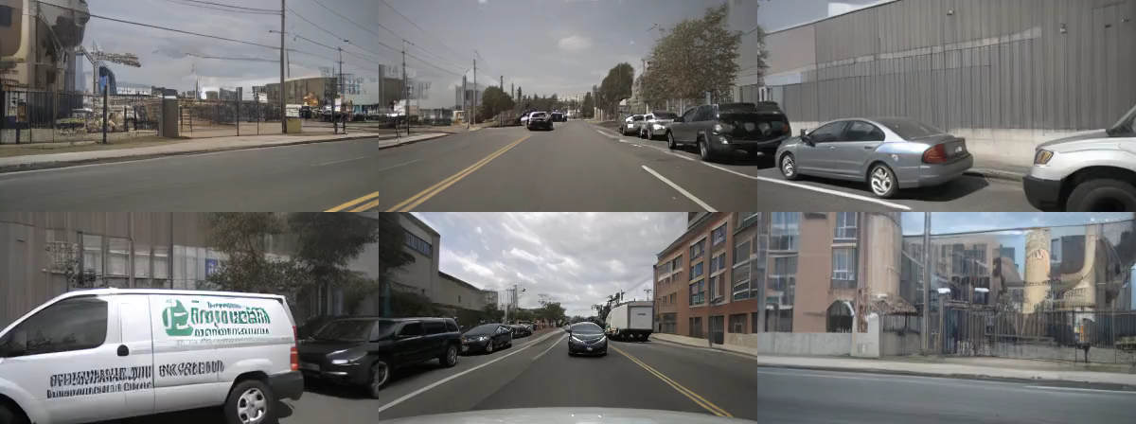
Track 2: Corner Case Scene Generation
This track aims to enhance diffusion models for generating multi-view street scene videos that align with 3D geometric descriptors, such as Bird's Eye View (BEV) maps and 3D LiDAR bounding boxes.
Building on the MagicDrive framework, this track strives for improved scene generation capabilities in autonomous driving, emphasizing consistency, higher resolution, and extended video duration.

Slide 25
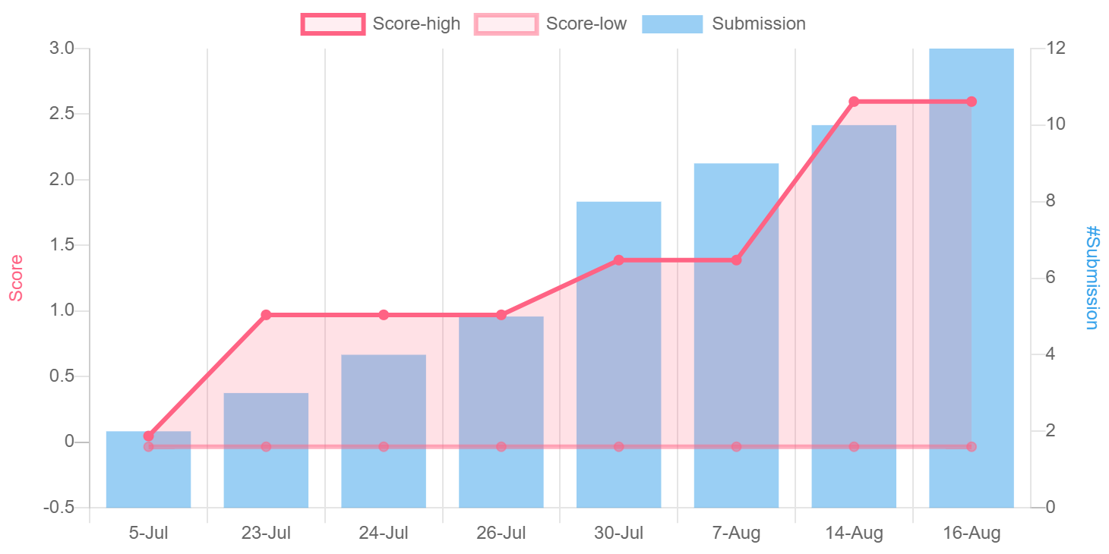
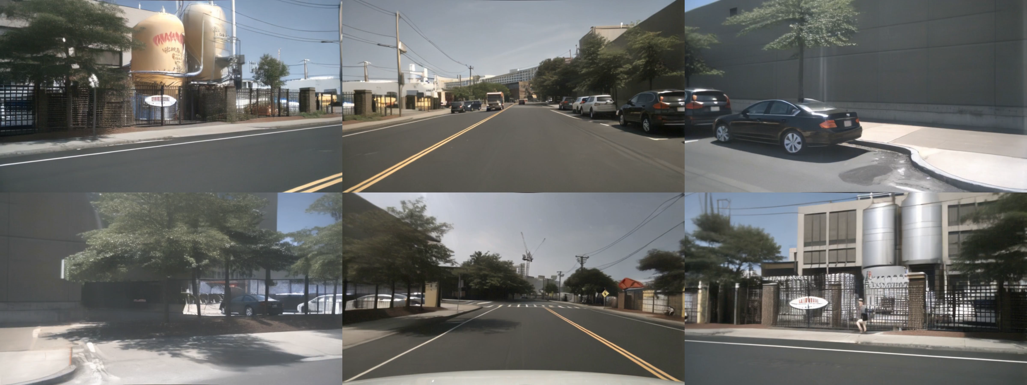
Track 2: Statistics
Submission:
🔥 Participants: 10+ teams, 40+ individuals, 20+ institutions
📊 Submissions: 10+ entries
Performance Improvements：
🚀 FVD: 218.12 → 94.60 (Stunning Improveent: 56.63%)
🌟 mAP: 11.86 → 24.55 (Remarkable Boost: 106.97%)
💡 mIoU: 18.34 → 35.96 (Significant Increase: 96.02%)
Impressive Results In Submissions!

Slide 26
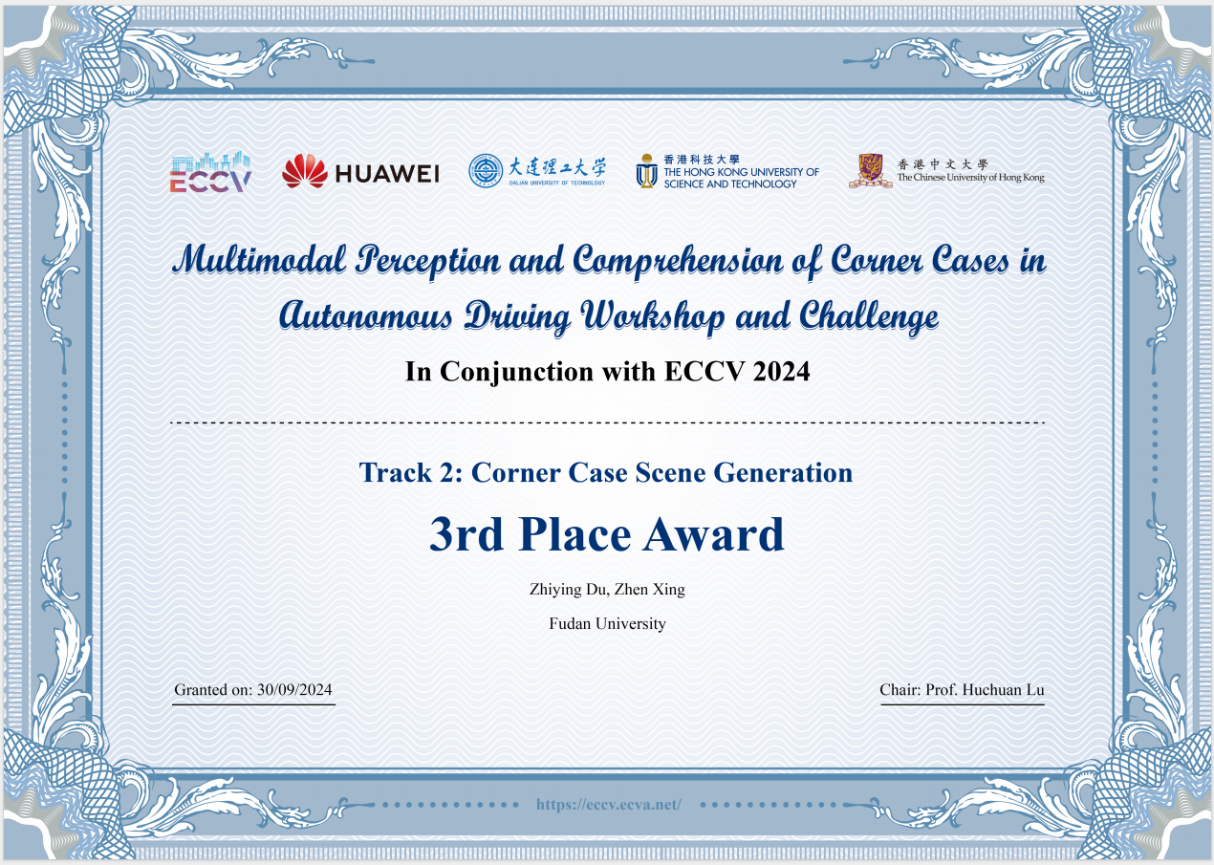
Track 2: Winner & Award
Notes:
奖状图片是旧的，需要更新

Slide 27
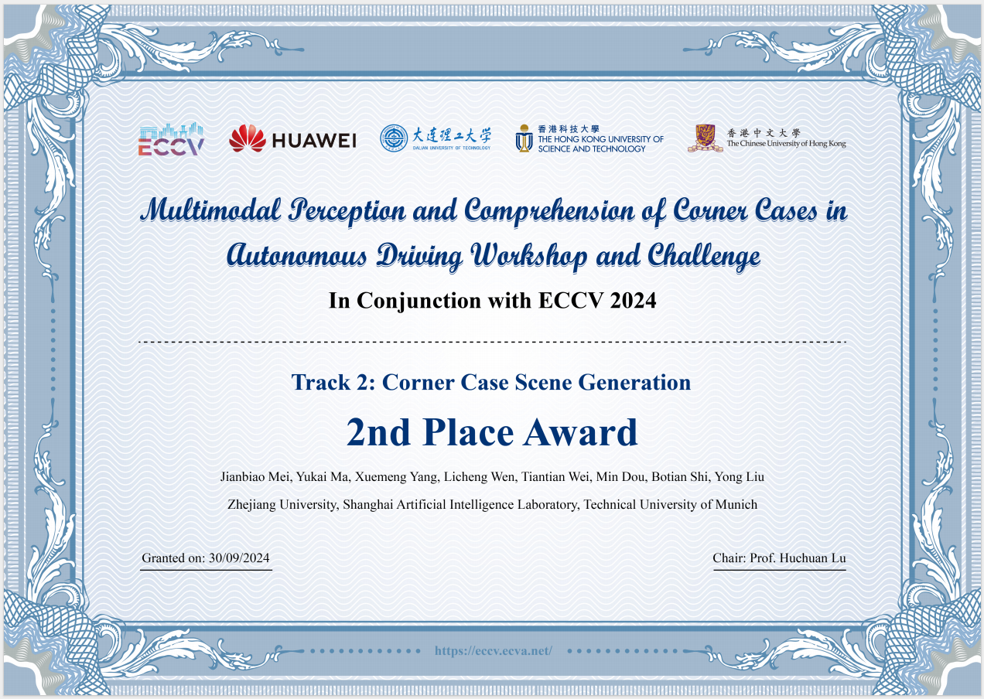
Track 2: Winner & Award
Notes:
奖状图片是旧的，需要更新

Slide 28
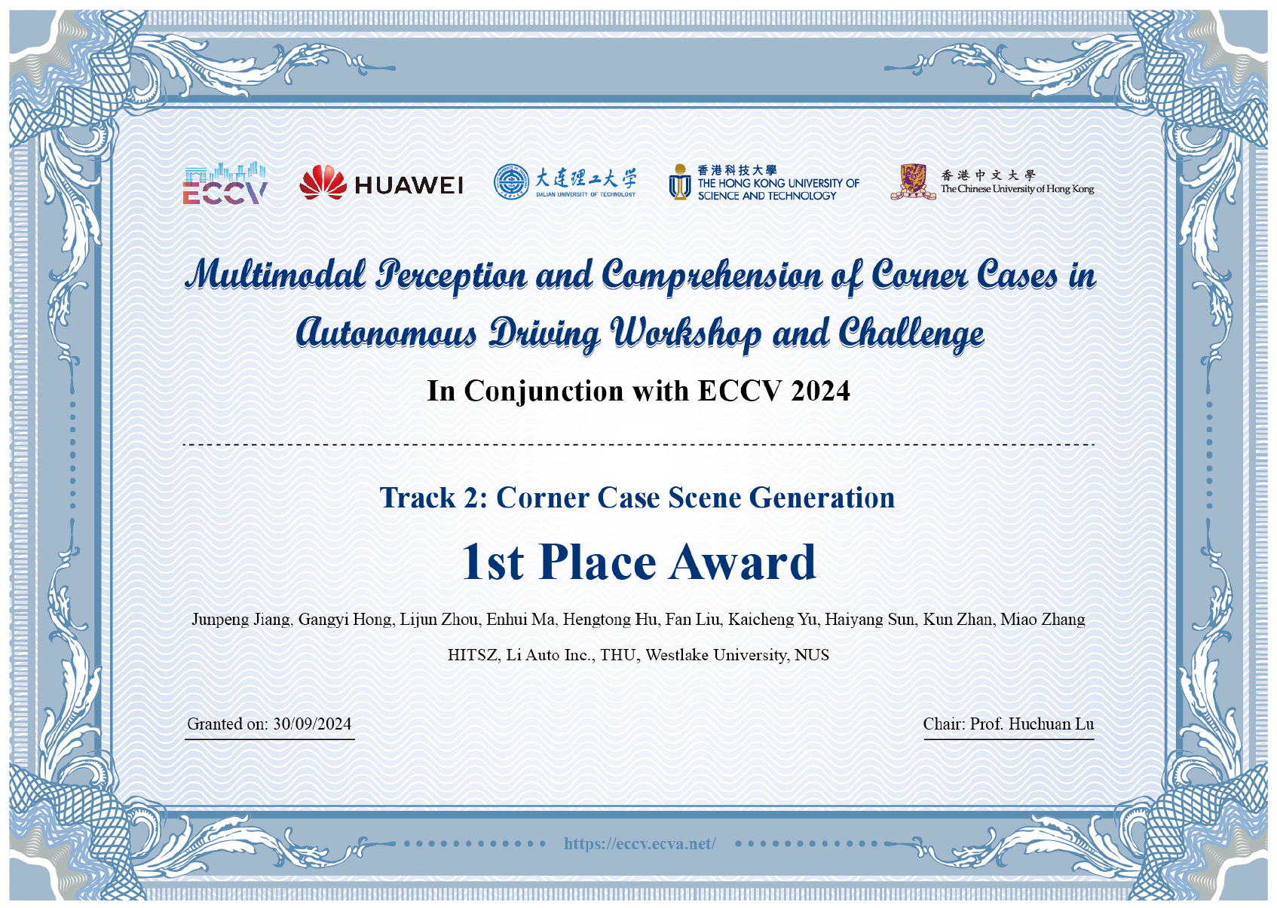
Track 2: Winner & Award

Slide 29
Post-Credits !!!

Slide 30
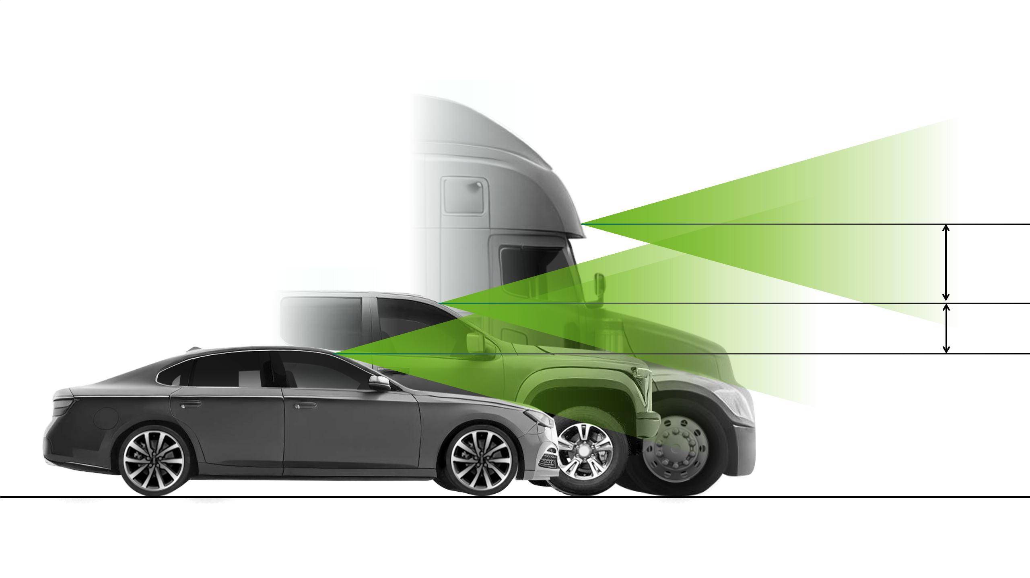
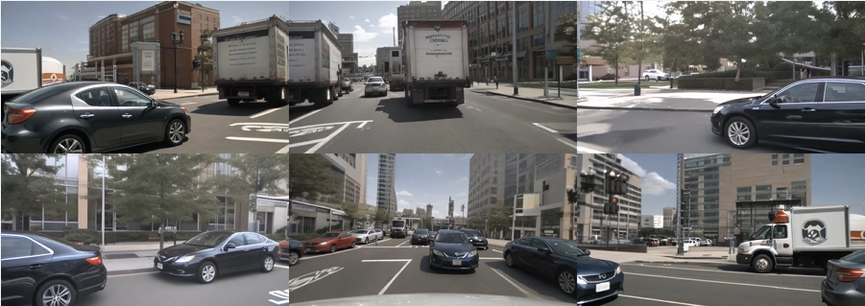
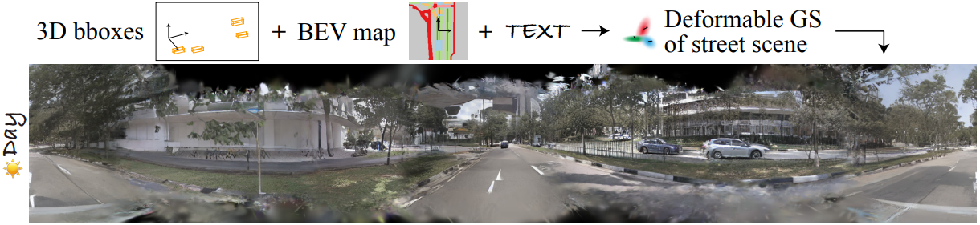
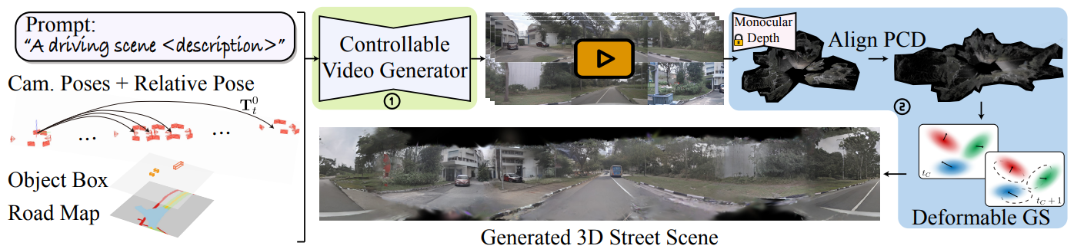
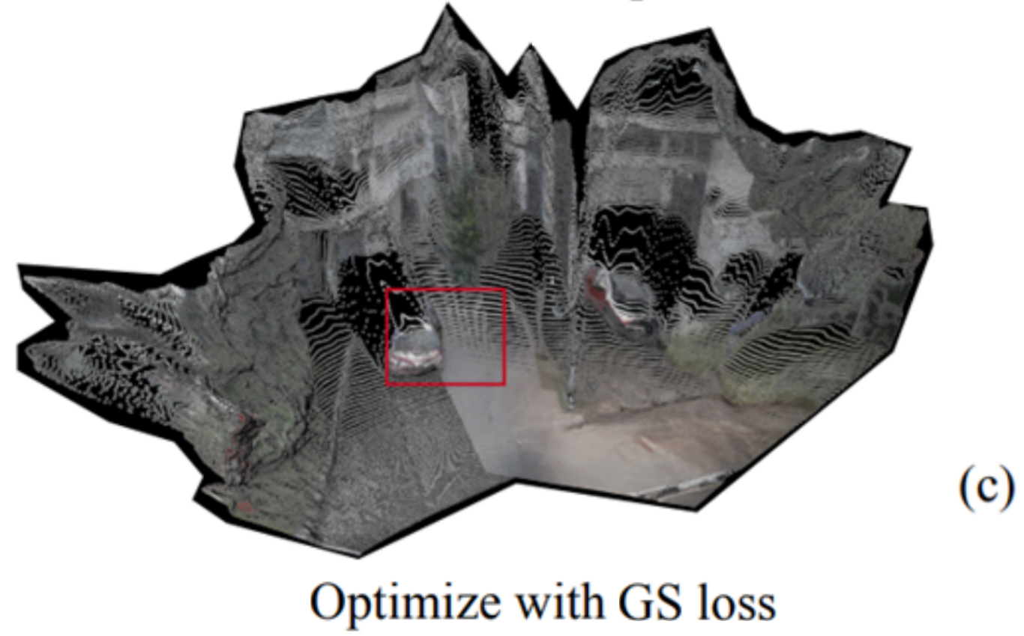
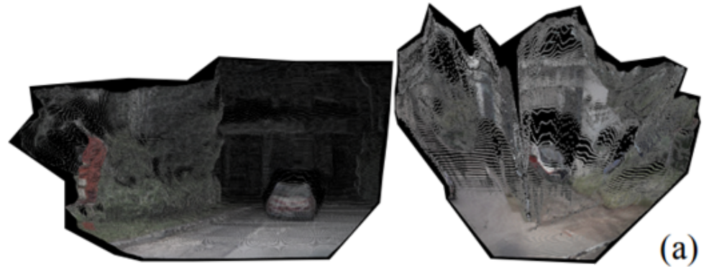
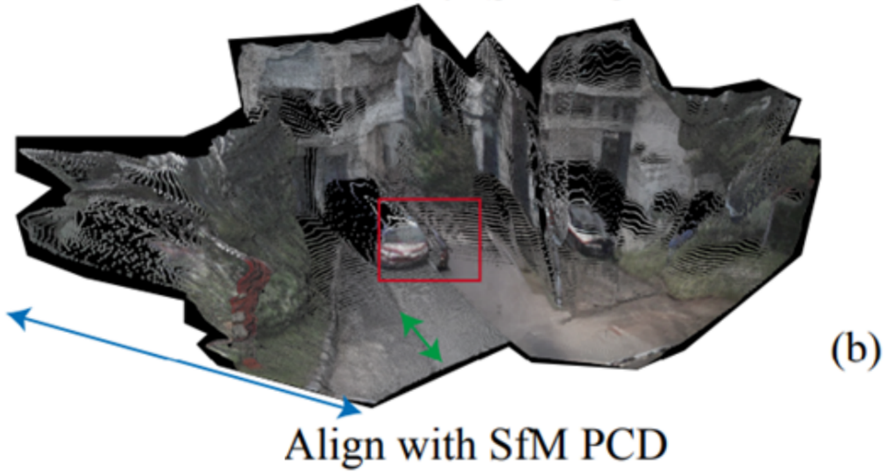
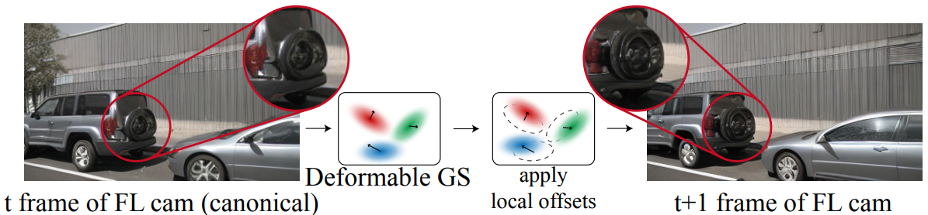
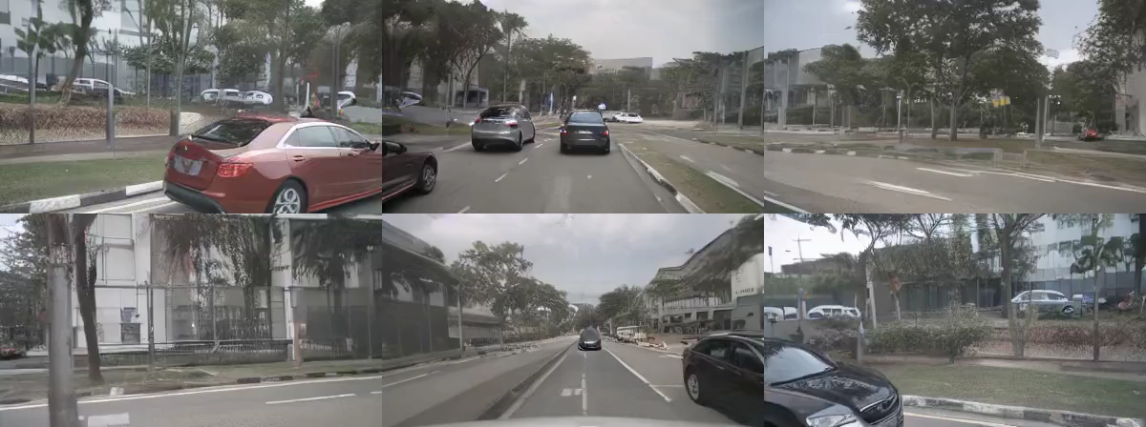
MagicDrive3D: Controllable Street Scene Generation
Motivation: From one static camera to any novel poses
?
Different vehicles, different camera
MagicDrive can only generate fixed poses
Unbounded controllable driving scene generation
Solution: Geometry-free Generation + Geometry-focused Reconstruction
Step 2: Generated view-friendly reconstruction
a. A better initial PCD
Step 1: Controls -> Reconstruction-friendly video
b. A better deformable representation
Static Scene Video
Keep ego movement
Remove other object movement
b. A better algorithm with appearance embedding
Dynamic Scene Video
https://gaoruiyuan.com/magicdrive3d/

Slide 31
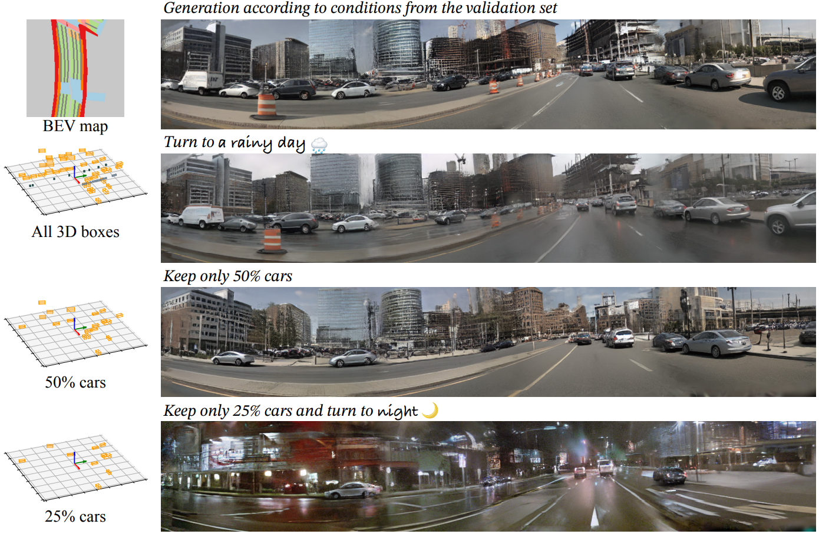
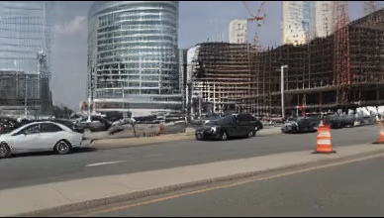
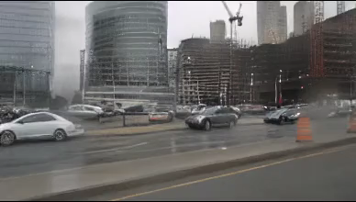
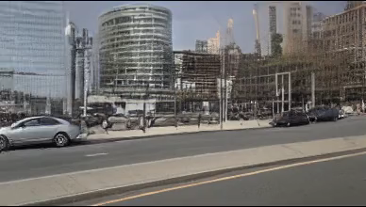
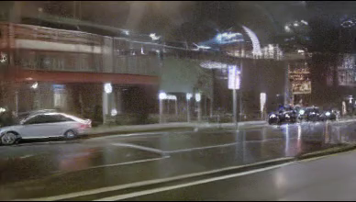
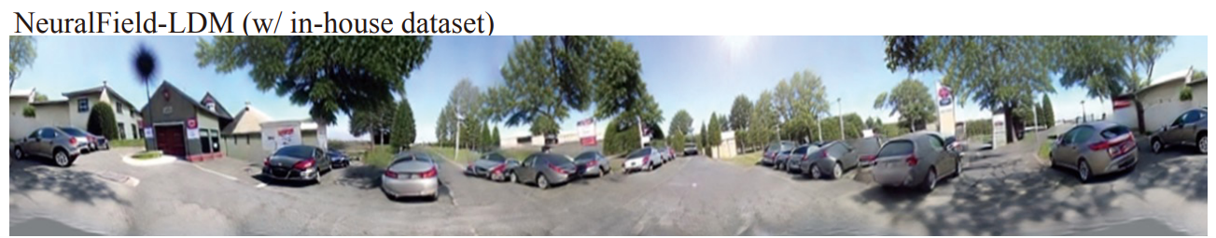
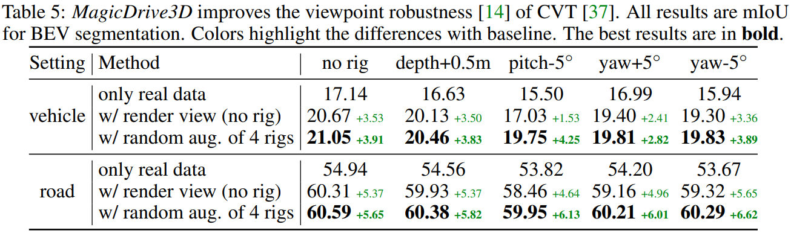

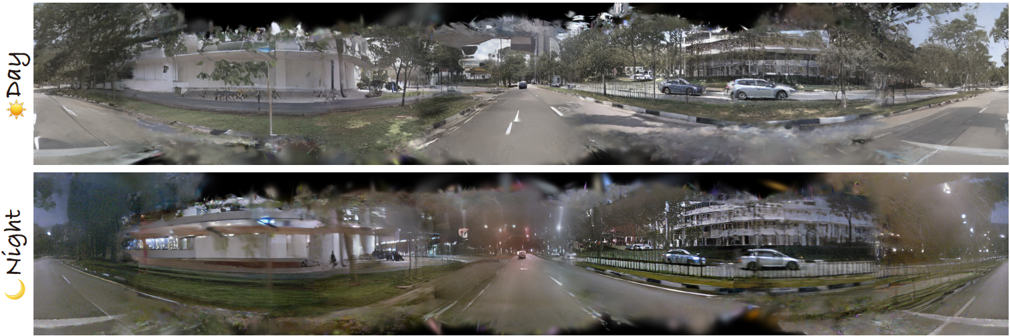
MagicDrive3D: Controllable Street Scene Generation
Results: From one static camera to any novel poses
Make perception model robust to camera pose change!
https://gaoruiyuan.com/magicdrive3d/

Slide 32
Summary & Future Plans

